Slide 1


SAP UI5 & FIORI with OData TRAINING
Anubhav Oberoy & Nishan Nainsukha
Day – 1

Slide 2

INTRODUCTION

Slide 3

Agenda – Day 1
Introduction to SAP UI5
What is SAP UI5?
Client Server Architecture
Introduction of MVC Architecture
UI5 Development Tools
Installation of development Tools
Working with GitHub
Trainer: Anubhav Oberoy & Nishan

Slide 4


What is SAP UI5?
SAPUI5 (SAP user interface for HTML5) is a collection of libraries that you can use to build desktop and mobile applications that run in a browser. With the SAPUI5 JavaScript toolkit, you can create web applications using HTML5 web development standards.
SAP UI5 is a framework which is used to develop Responsive web applications to run on any platform, any browser and any OS.
Responsive
App which can adapt itself according the different devices
Framework
It’s a collection of Libraries.
Library
Collection of classes.
Classes
Collection of methods, Attributes, Events
Software Innovation
Hardware Innovation
Trainer: Anubhav Oberoy & Nishan

Slide 5
Evolution of SAP UI Technologies
Dynpro
Web Dynpro
WebGUI
SAPUI5
BSP
Trainer: Anubhav Oberoy & Nishan

Slide 6
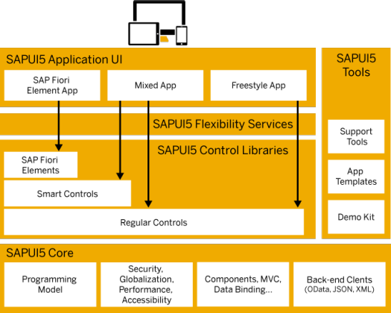
Under the Hood of SAP UI5
SAPUI5 simplifies web application development. A variety of UI controls, ranging from basic elements to complex UI patterns, can be combined for an appealing layout. All UI controls leverage a consistent design language and coherent UX patterns. SAPUI5 flexibility services let you easily adapt the UI of an app and store the changes in a layered repository.
Trainer: Anubhav Oberoy & Nishan

Slide 7
Client Server Architecture
The task of the client/server technology components is to provide a reusable runtime environment for other components that use the client server technology as the basis on which to process requests. The focus is on optimizing operating system resources (CPU, memory, etc.), in terms of performance, scalability, and robustness.
In addition to the components in the SAP kernel there are programs that regulate data traffic in the network, such as the SAP router and the SAP Web Dispatcher, as well as smaller monitoring and test programs.
SAP
Server
Computer on cloud
IP Address
Fiori
Request – header + body(optional)
Response – header + body(html,xml, json,excel, pdf, word,….)
Request Types
GET – Read Data
POST – Create new Data
PUT – Update
DELETE – Remove Data
Trainer: Anubhav Oberoy & Nishan

Slide 8
Introduction to MVC Architecture
MVC stands for Model, View, Controller.
Model:- The model component is a freely composed class that will keep the application data and do manipulations on it. All database accesses are done within the model.
View:- The View is responsible for defining the user interface to users. When a user sends a requests from his device, the view is responsible for data view as per the request submitted.
Controller:- The Controller is used to control the data and view events as per user interaction by updating the view and model.
<event>
Processing
Controller
eventHandler
<notifies>
<done>
<modifies>
I/O
View
Data binding
Data
Models
MVC Architecture

Slide 9

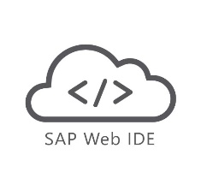

UI5 Development Tools
Development Tools
BAS is the latest technology provided by SAP for Development
Eclipse
Web IDE
SAP Web IDE comes in two type
Business Application Studio (BAS)
Eclipse development tools is Obsolete
It is no longer supported by the SAP
But we can still use it for local development in our system.
This tool is a Dead technology.
Web IDE Personal Edition
Web IDE Full-Stack
SAP Business Application Studio is the next generation of the iconic SAP Web IDE.
It comes out of the box with predefined set of development environments – Dev-Spaces (virtual machine on the cloud) tailored for developing SAP business scenarios.
It Installs in our local system and runs on the browser.
It requires JAVA 1.8 to be installed in system.
It runs offline.
Support for Web IDE is also stopped by SAP in 2019.
SAP Web IDE Full-Stack runs on SAP Cloud Platform
It needs no installation
It allows you to integrate with other services that run on the platform
SAP Fiori Cloud apps
Git integration
mobile services
IoT services and more.
Trainer: Anubhav Oberoy & Nishan

Slide 10
UI5 Development Tools
Local Computer Cloud Computer
No internet required
Required admin rights to install software
Convenient
Responsible for backup
Faster
Almost no cost
Port application to another PC/laptop manually
System crash everything goes
Hardware cost (8 GB RAM, 100 GB, > i3)
Options
SAP WebIDE (obsolete)
VS Code (recommend)
internet required
No installation required
Convenient (cant develop when offline)
Source code is on cloud
Moderate (depends on speed)
Almost no cost for 365 after that you need to pay
Switch device (suitable for corporate laptops)
System crash wont affect us
Low cost and faster adoption
Options
Business Application Tool (BAS) – 365 days is free
Trainer: Anubhav Oberoy & Nishan

Slide 11
Installation of the Development Tools
Click the Link to download Web IDE PE
https://tools.hana.ondemand.com/
01
Download SAP Web IDE PE
02
Paste the file in c:/MyWebIDE
Extract the file in the folder using
WinRAR software (it will take 5-10 min)
After extraction we will see a folder named eclipse and inside it there is a file named orion.exe
03
Open the extracted folder
04
Run Orion.exe as administrator
Right click on orion.exe and run it as
Administrator and press OK
Steps to Install Web IDE
05
Create a shortcut
Create a Shortcut of Orion.exe on the desktop for
the your convenience. (Optional)
Prerequisites:-
Must have JDK 1.8 in System.
Min 4GB of RAM.
Must have Installed WinRAR in your system.
06
Now start the Orion.exe
Start the Orion.exe by double clicking on it.
07
Don’t close the cmd window
Do not close the command window once it is
Started.
08
Go to Browser
Once the orion.exe is started go to your browser and
Open link:- http://localhost:8080/webide/index.html
Trainer: Anubhav Oberoy & Nishan

Slide 12
Installation of the Development Tools
VS code:
VS code a open source development tool (IDE) by Microsoft for developer community. Billions of developers across industry use this tool for all kinds of development (web, android, erp apps, fiori). Hence SAP also recommend to follow industry best practice. The BAS is a copy of VS Code (local BAS). If you adopt VS Code, you don’t need to buy SAP BAS subscription so it’s a cost saving for company.
Pre-requisites
Node JS to be installed (min v10) – node –v
Download and install node js from here
We need to install SAP UI5 tooling used by Node JS (support module to work with ui5 apps) – npm install –g @ui5/cli
Steps to install VS Code
Download and install VS Code for free from here
Open the VS Code
Add A folder C:\UI5 Project\basics ← project name
Create webapp/index.html file and same content like WebIDE
Run following command by opening terminal in VS Code and go inside project directory
npm init
ui5 init
6. Inside the webapp folder, create a file manifest.json
7. Start web server using command ui5 serve
Trainer: Anubhav Oberoy & Nishan

Slide 13
Installation of the Development Tools
Click on GO
Create free trial account
Launch your cloud platform
trial cockpit - Click
BAS SETUP
On main screen you will see BAS
Click and Create Dev Space &
choose Fiori as Dev Space Type
Trainer: Anubhav Oberoy & Nishan

Slide 14
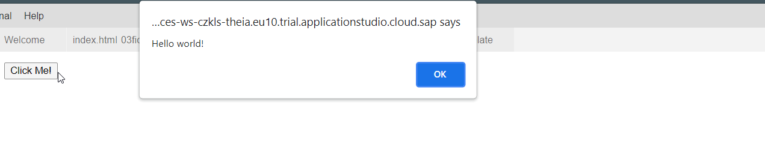
Creating First Program In HTML
Create a Program with a Button using below code:
Code:
<html>
<body>
<button type="button" onclick="alert('Hello world!')">Click Me!</button>
</body>
</html>
Output:
Trainer: Anubhav Oberoy & Nishan

Slide 15
Git Hub Using Command Line
Create Git Repo From command line (First push):
Open the terminal, and Open your Project folder
Run Command git init
git add .
git commit -m "first commit“
git branch -M main
git remote add origin https://github.com/<Git-id>/<Repo-name>.git
git push -u origin main
Pushing to an Existing From command line:
git add .
git commit -m “<message>"
git push
Trainer: Anubhav Oberoy & Nishan

Slide 16
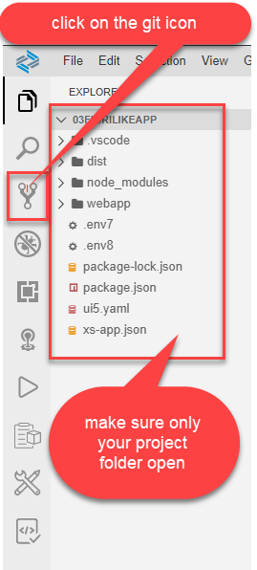
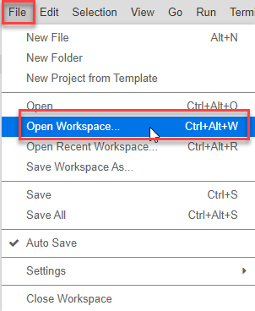
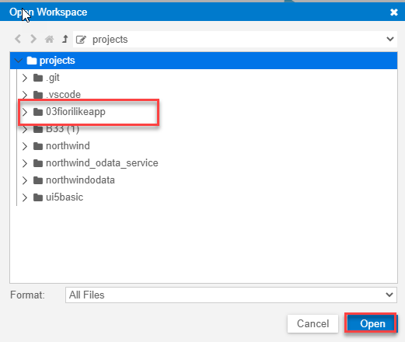
Git Hub Using BAS UI
Opening the project in the workspace
Trainer: Anubhav Oberoy & Nishan

Slide 17
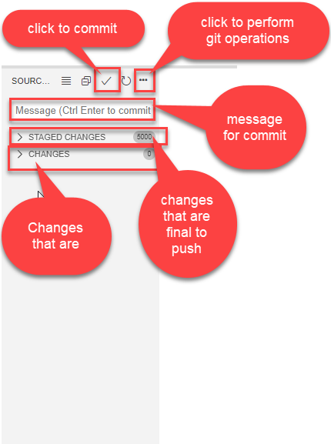
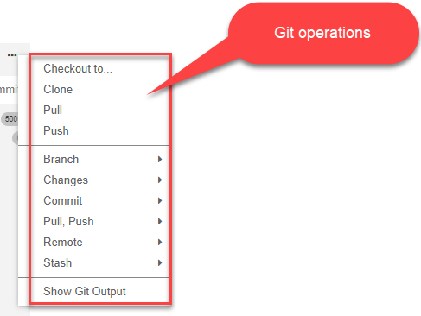
Git Hub Using BAS UI
After click on git, git tab is open where we can see our changes and also commit them & push to the git
Trainer: Anubhav Oberoy & Nishan

Slide 18

End of Day 1

Slide 19

Questions
Trainer: Anubhav Oberoy & Nishan

Slide 20

Anubhav Oberoy

Slide 21


We’re committed to empower you to be
Most Desirable Resource
through powerful training solutions.
We build the workforce of the future.
250+
Corporate Clients
30,000+
Learners Trained
25000+
Learners Placed
FREE WEBINARS
Sign up for free webinars with industry experts every fortnight!
Enroll Now!
Contact us today!
https://anubhavtrainings.com/

Slide 22




More from AnubhavTrainings.com

